Slide 1
Year 12 Media Outcome 1: Narrative
Strangers on a Train

Slide 2
Strangers on a Train
NARRATIVE ELEMENTS
Plot and story
Structure
Compression of time
Opening and closing
Characters
Setting
Themes, issues and motifs
Point-of-view
Cause and effect

Slide 3
Strangers on a Train
Plot and story
Plot begins with Bruno and Guy arriving at the station, ends with Anne and Guy on a train.
Story includes elements such as the breakdown of Guy and Miriam’s relationship, Guy meeting Anne and her family, and Bruno becoming estranged from his father.

Slide 4
Strangers on a Train
Structure
The plot is strictly linear, though other narrative elements serve to keep things interesting.
Three-act structure
Act 1: Ends with the murder of Miriam (Guy’s “point of no return”)
Act 2: Ends with Guy leaving Bruno’s house – Bruno will “think of something”
Act 3: Ends when the film ends (contains crisis and climax).

Slide 5
Strangers on a Train
Compression of time
A scene like the one between Guy and Bruno in Bruno’s train compartment is quite lengthy and plays out in more or less ‘real time’. There is little compression of time there. This gives the audience a stronger sense of ‘being there’, experiencing the tension between the characters at the same time they do.

Slide 6
Strangers on a Train
By contrast, the time from when Guy begins his tennis match at Forest Hills to the aftermath of the carousel crash is compressed considerably – several hours are compressed down into roughly twenty-five minutes.

Slide 7
Strangers on a Train
This compression of time is dictated by the script, and demonstrated in the mise-en-scene, such as the sun setting in the distance behind Guy or the numerous clocks we are shown.
It also comes through the editing, especially when we see that the sun has set further behind Guy than behind the fair at Metcalf.

Slide 8
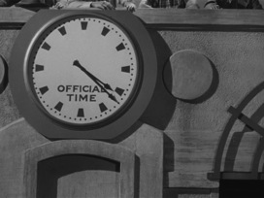
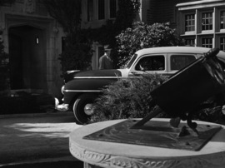
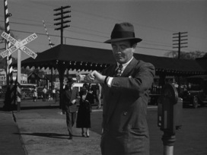
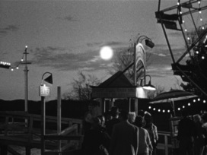
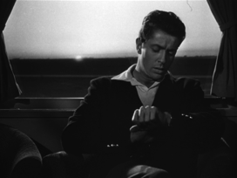
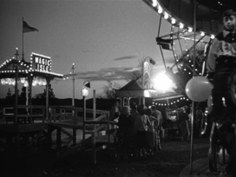
Compression of time

Slide 9
Strangers on a Train
It also comes through the sound, especially through the dialogue of the tennis commentator and the umpire.
(“Game Mr Reynolds...Advantage Mr Reynolds...Game Mr Reynolds.”)

Slide 10
Strangers on a Train
Opening
Opening does many things:
Credits establish mood and location.
Sets up characters of Guy and Bruno through costumes (flamboyant sports shoes for gregarious Bruno, sensible work shoes for conservative Guy)
Sets up idea of the ‘double’ - editing and camera movement convey that they’re different but somehow connected, heading unstoppably towards each other.
Railway tracks serve as a symbol of paths colliding (as Bruno calls it “criss-cross”).

Slide 11
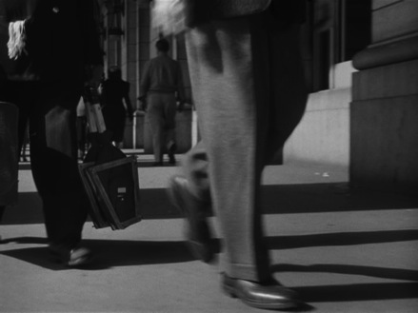

Slide 12
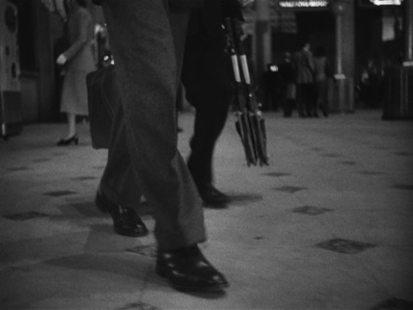

Slide 13
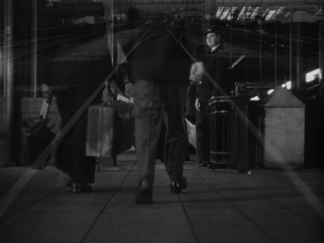

Slide 14
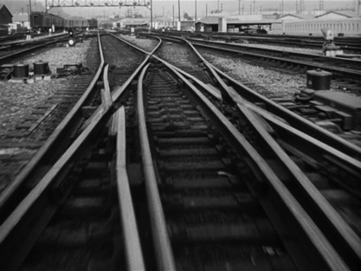

Slide 15
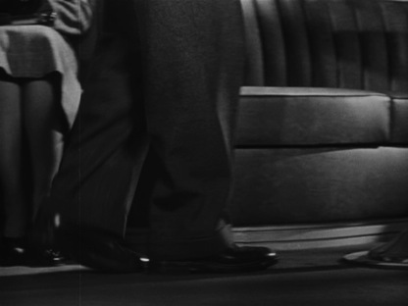

Slide 16
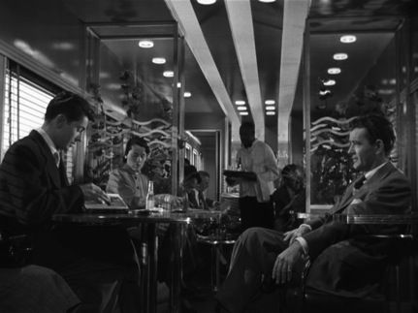

Slide 17
Strangers on a Train
Closing
Closing is abrupt, but has the effect of a punchline, thereby relieving tension and drawing attention to the director; it’s like Hitchcock is giving the audience a wink.
In this way it serves as a model of the ‘pleasure/pain’ dichotomy – Hitchcock knows we go to the movies to be both scared and delighted.

Slide 18
Strangers on a Train
Closing
A priest asks Guy what Bruno originally asked him, but Guy’s character has developed so he knows better than he did at the start.
Character resolution: it seems important that we see Guy with Anne. He has gotten the girl and, therefore, the political career (and the secure masculinity).

Slide 19
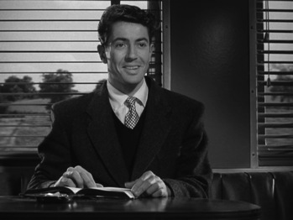
Strangers on a Train
Characters
Guy Haines (Farley Granger)
Established as the protagonist: clean-cut, moral, handsome, conservative, has physical prowess (tennis) but ambitious – wants to be a politician. “I may be old-fashioned but I thought murder was against the law.”

Slide 20
Strangers on a Train
Develops as he is presented with challenges, mainly by the antagonist, Bruno. Becomes more of a risk-taker (as the tennis commentator suggests, he moves away from his usual “watch-and-wait” strategy).

Slide 21
Strangers on a Train
Relationship with Bruno is central to the film. Bruno can be seen as representing Guy’s “shadow” (his ‘dark side’ – the things he doesn’t want to admit about himself).
Relationship with Anne is important, particularly for how under-developed it is.

Slide 22
Strangers on a Train
Guy’s overarching motivation seems to be his desire to break into politics. Whether this is a result of the survival instinct or male competitiveness is a matter of opinion. This also helps to explain his rather bloodless relationship with Anne.

Slide 23
Strangers on a Train
Mervyn Nicholson says: “There is no indication of any political agenda or cause that means anything to this young man. [He is] someone who wants to climb the ladder of power and prestige...perhaps fuelled by strong feelings of social inferiority (symbolised by Miriam) and of threatened identity due to failed ambition.”

Slide 24
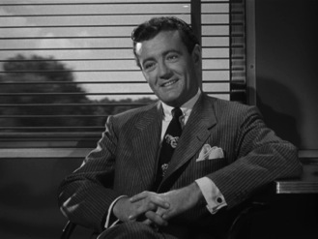
Strangers on a Train
Characters
Bruno Antony (Robert Walker)
Established as the antagonist: suave and smooth but effeminate and, therefore, threatening to Guy. Established as a loser or a ‘bum’ in comparison to Guy: “I certainly admire people who do things.”

Slide 25
Strangers on a Train
Minimal development across the course of the narrative. His strengths and weaknesses at the end are the same as at the start.

Slide 26
Strangers on a Train
The only thing that really changes is how much information the audience has about him. His guilt over Miriam’s murder (to the point of collapsing at the party) is the first real sign of his weakness, but we can assume this is an innate aspect of his character.

Slide 27
Strangers on a Train
His relationship with Guy is key.
His close relationship with his mother is significant, and is used to suggest his homosexuality or, at least, his ‘difference’. There is an Oedipal quality to their relationship; that is, she seems closer to Bruno than she does to her husband.

Slide 28
Strangers on a Train
His relationship with his father hints at his estrangement (or “long distance”) from the patriarchal American society. The bemused response of Anne’s father, Senator Morton, when he meets Bruno, helps to reinforce how distant Bruno is from the ‘norm’.

Slide 29
Strangers on a Train
His motivation echoes that of Guy’s. He wants to be accepted by society, and thinks he can achieve this if he can merge his persona with Guy’s...to, in a sense, ‘become’ Guy.

Slide 30
Strangers on a Train
Unfortunately for him, he just isn’t up to it because he’s a psychopath. His methods of getting what he wants are not morally or socially acceptable, whereas Guy’s are. Playing tennis, getting into politics and romancing a refined lady are far more acceptable ways of “winning” than murder.

Slide 31
Strangers on a Train
Setting – physical/geographical
United States, 1951.
New York City: Forest Hills Tennis Club
Metcalf: fictional town between NYC and Washington DC. Guy and Miriam’s hometown.
Washington DC: Political centre of USA. Guy lives there now, as do the Mortons.

Slide 32
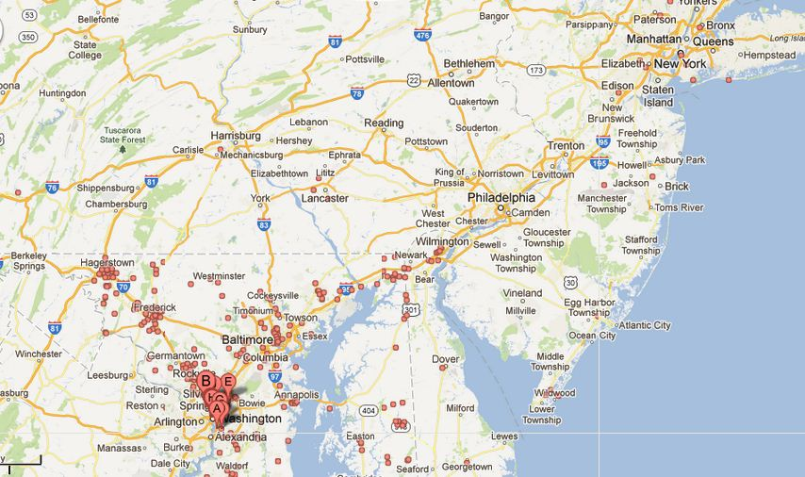
Strangers on a Train
Setting – physical/geographical

Slide 33
Strangers on a Train
Setting – physical/geographical
New York City: represents success, “winning”.
Metcalf: represents Guy’s old “loser” life, connected closely to Miriam. The amusement park is a place to kill time.
Washington DC: represents Guy’s aspirations to be involved in politics.

Slide 34
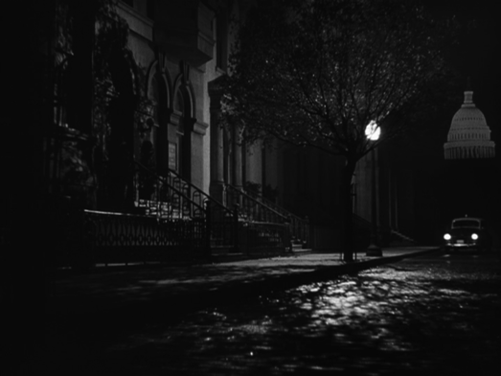
Strangers on a Train
Setting – physical/geographical
The Capitol Building (House of Congress) looms large over the street outside Guy’s house. Close inspection reveals it’s a composite image, so it’s a very deliberate choice on Hitchcock’s part.

Slide 35
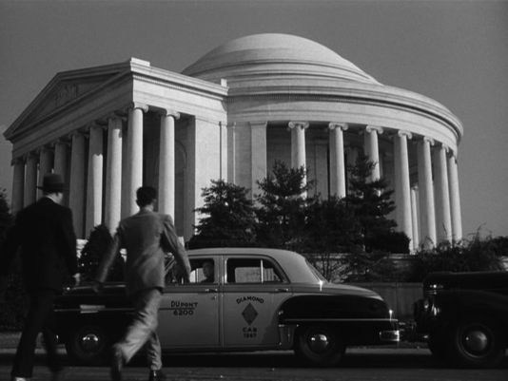
Strangers on a Train
Setting – physical/geographical
The Thomas Jefferson Memorial. Bruno stands ominously on the steps as Guy drives past, an obstacle to Guy’s political ambitions.

Slide 36
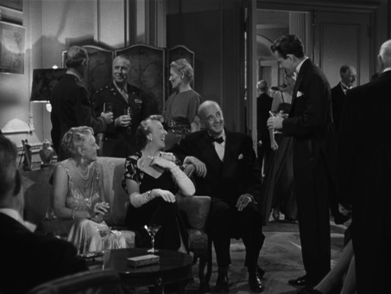
Strangers on a Train
Setting – social
Wealthy, proper, upper-class society in Washington. Very white (and note the black manservants). At the party are the d’Arvilles (representative of education and culture), the judge (symbol of mainstream morality) and important military men.

Slide 37
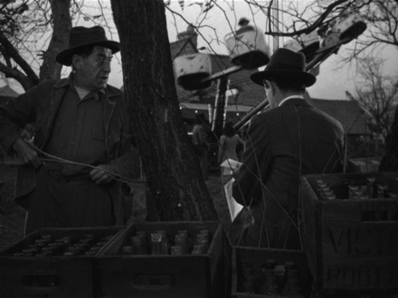
Strangers on a Train
Setting – social
Washington contrasts with the simple, small-town values of Metcalf. In the scene at right, the tree, a bold slash down the middle of the screen helps to emphasise the divide between Bruno and the amusement park man, who says, “Okay, so I ain’t educated.” And the crates of cheap root beer stand in stark contrast to the martinis of the Washington soiree.

Slide 38
Strangers on a Train
Setting – emotional/atmospheric
Hitchcock “plays against type” with his settings, especially at the amusement park.

Slide 39
Strangers on a Train
The amusement park is typically a place of frivolity and fun, but because we know that Bruno is intent on killing Miriam, the atmosphere becomes much more sinister. Setting it there makes it perhaps even more frightening than if it were in a dark alley, or a seedy bar. This is emphasised by the insistent organ-grinder style music arranged and selected by Dimitri Tiomkin, and the high-contrast tonality of the images.

Slide 40
Strangers on a Train
It’s also symbolic of Guy’s psyche. It is in Metcalf, his home town, which connects it to his youth and the formation of his character.
The fact that Bruno ventures into not only Guy’s hometown (his psyche) but into the part of it devoted to freedom, liberation and pleasure, passing through the “tunnel of love” on the way, to kill off the thing holding Guy back from being free and happy (Miriam), makes it even more symbolic.

Slide 41
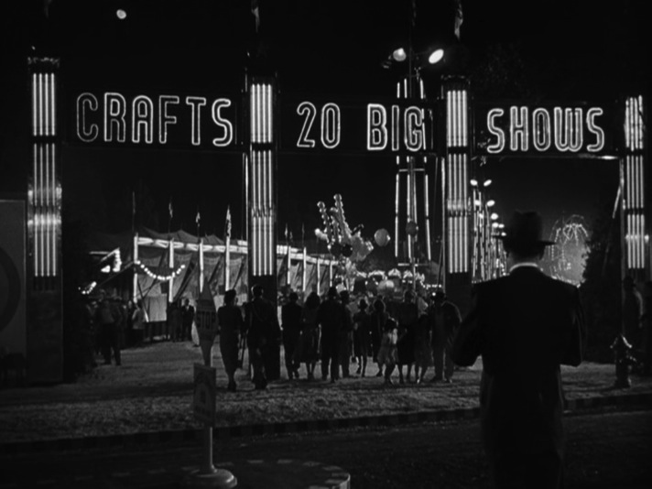
Strangers on a Train

Slide 42
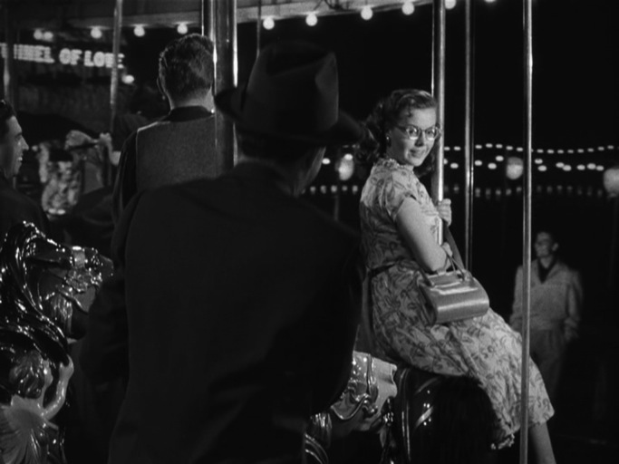
Strangers on a Train

Slide 43
Strangers on a Train
Consider the significance of the lyrics to “The Band Played On”:
Casey would waltz with a strawberry blonde
And the band played on;
He'd glide 'cross the floor with the girl he adored
And the band played on;
But his brain was so loaded it nearly exploded
The poor girl would shake with alarm;
He'd ne'er leave the girl with the strawberry curls
And the band played on.

Slide 44
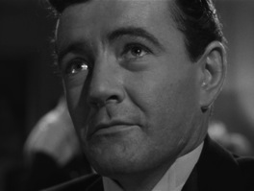
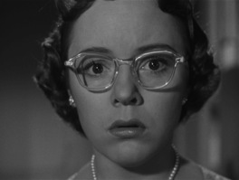
Strangers on a Train
Themes
Innocence and guilt
Is Guy guilty because he wished Miriam were dead?
Guilt is the one thing that weakens Bruno, but it only shows itself under certain circumstances (i.e. when he sees Babs). What is it about Babs that draws out Bruno’s guilt? Is it just the resemblance to Miriam?
The line between guilt and innocence is very fine.

Slide 45
Strangers on a Train
Themes
Fate vs. self-determination
We can never completely control our fate. Guy and Bruno are on the “tracks” of their lives and there is no getting off them – just as there is no getting off the carousel.
Both characters seek to control their fate but only Guy gets what he wants. Why does fate smile upon him?

Slide 46
Strangers on a Train
Issues
Social class
Guy is looking to move up a social class from his lower-middle upbringing in Metcalf, of which Miriam is symbolic. He realises he’ll need to work hard to do this but also, arguably, takes advantage of his connection with Anne for social progression.

Slide 47
Strangers on a Train
Issues
Social class
Bruno is born into wealth but is ambivalent towards it. He seems to have no desire to leave home, nor is he willing to work for his father. Though his mother says he gets up to “all sorts of escapades”, he seems to contribute nothing to society. Still, he clings on to his social airs and graces when he realises they can pull him up into Guy’s milieu (such as at the tennis or at Babs’ party). He also prides himself on his ‘education’: “I’m sure I don’t know what a smoocher is.”

Slide 48
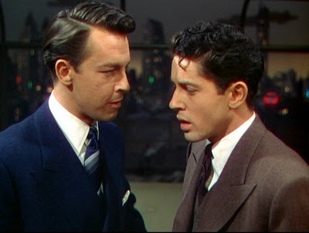
Strangers on a Train
Issues
Sexual repression
Many critics have viewed the film as an exploration of sexual psychology, arguing that Guy is gay and that Bruno is simply a representation of Guy’s homosexual desires (which lurk forever in the ‘shadows’).

Slide 49
Strangers on a Train
Issues
Sexual repression
This is simply an interpretation, as explicit references to any character’s homosexuality are absent. But there is a good deal of evidence to support it.
For a start, sexuality was a typical issue for Hitchcock’s characters to grapple with. Homosexuality figured most notably in Rope (1948), which stars Farley Granger (Guy!) and John Dall as a pair of murderous gay lovers.

Slide 50
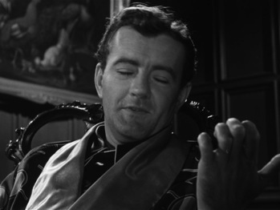
Strangers on a Train
Issues
Sexual repression
Bruno is depicted as homosexual. His smooth, slightly effeminate way of speaking; his close relationship/identification with his mother; his distance from his patriarchal father; his fastidiousness about his nails; his flamboyant shoes: all of these elements would have been recognisable (albeit stereotypical) gay characteristics to audiences at the time.

Slide 51
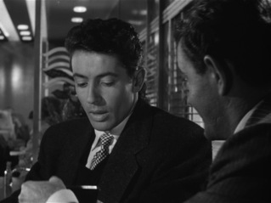
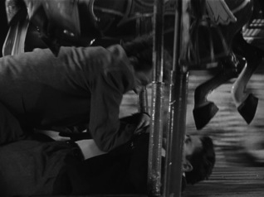
Strangers on a Train
Issues
Sexual repression
Whether or not this means Guy is also gay is a matter of opinion, but it does help to explain a lot of things: his desperation to fit in to society; his unconvincing relationship with Anne; his rejection of Bruno; the lustful quality of his grappling with Bruno on the carousel...and the Freudian notion of the repressed sex drive is explored in so many of Hitchcock’s film.

Slide 52
Strangers on a Train
Issues
Sexual repression
To figure out what Hitchcock is suggesting about homosexuality is difficult. The ‘gay guy’ is clearly also the ‘bad guy’ (thereby equating ‘gay’ with ‘bad’), but we are so often invited to empathise with him and enjoy his antics. He is certainly more fun than Guy or Anne.
Perhaps the film is a depiction of how difficult it was to be gay (or sexually aberrant in any way) at the time...

Slide 53
Strangers on a Train
Motifs
The double
Truffaut said to Hitchcock, “This picture is systematically built around the figure ‘two’...Whether it’s Guy or Bruno, it’s obviously a single personality split in two.” Hitchcock agreed, saying: “That’s right. Though Bruno has killed Guy’s wife, for Guy it’s just as if he had committed the murder himself.”

Slide 54
Strangers on a Train
Motifs
The double
Consider all the doubles in the film:
Guy and Bruno
Miriam and Barbara (girls with glasses)
Two taxis
Two pairs of feet
Two suitcases
Two tennis rackets
Two train tracks
Double scotches, a pair
Two boys with Miriam
Hitchcock carrying a double bass as a double of himself
Mrs Cunningham and Mrs Anderson
Captain Turley and Sergeant Campbell
Hennessey and Hammond...(the list goes on).

Slide 55
Strangers on a Train
Motifs
The double
Freud's first thesis:
The uncanny (of which ‘the double’ is an example) arises due to the return of repressed infantile material. It can represent firstly, everything that is unacceptable to the ego, all its negative traits that have been suppressed, or it can embody all those utopian dreams, wishes, hopes that are suppressed by reality.

Slide 56
Strangers on a Train
Motifs
The double
This has particularly interesting implications for Guy and Bruno. Bruno could represent everything that Guy has repressed about himself (whether it’s homosexuality or his primitive, socially unacceptable urges in general – think “I could strangle her!”), while Guy represents to Bruno everything that he wants to be – the perfect man, accepted into the utopian lifestyle of Washington politics. In this way, they complement each other perfectly.

Slide 57
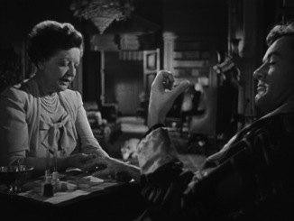
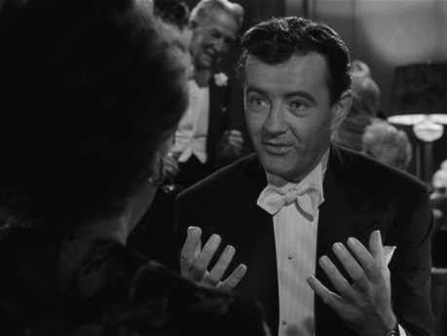
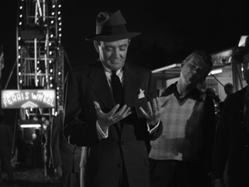
Strangers on a Train
Other motifs
Hands, especially Bruno’s

Slide 58
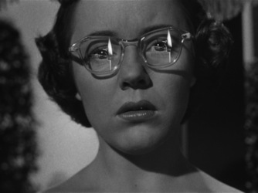
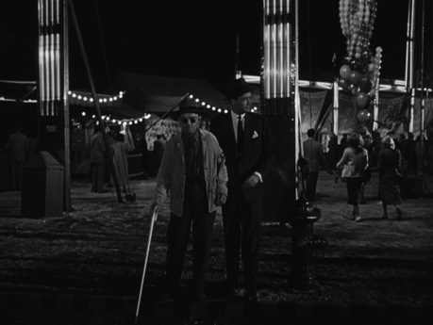
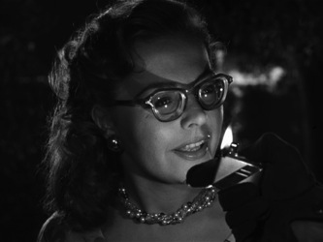
Strangers on a Train
Other motifs
Eyes and seeing

Slide 59
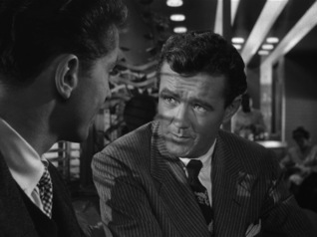
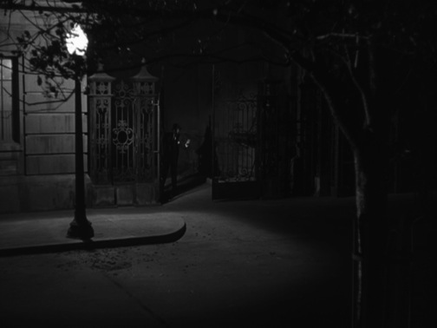
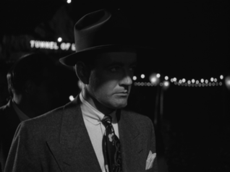
Strangers on a Train
Other motifs
Light and shadow

Slide 60
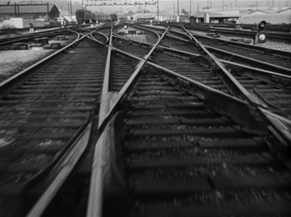
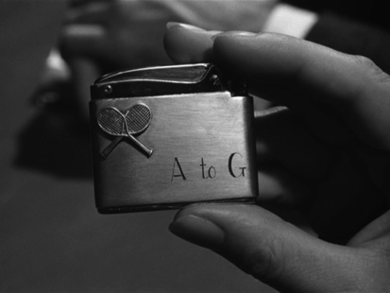
Strangers on a Train
Other motifs
“Criss-cross”

Slide 61
Strangers on a Train
Point-of-view
Story-wise, the audience’s point-of-view is generally omniscient, but we are invited to empathise in quite equal measure with Guy and Bruno.
There are only a few scenes that don’t relate to their perspectives, such as: Babs telling Anne about Bruno’s “trance”; Babs sweet-talking Hennessey; Hennessey and Hammond talking; and the shots of the train tracks.

Slide 62
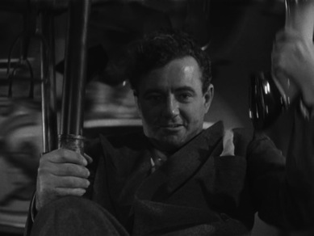
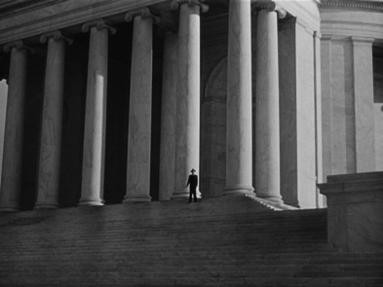
Strangers on a Train
Point-of-view
There are many moments where the camera work is subjective, or very close to it...

Slide 63
Strangers on a Train
Cause and effect
Important examples of cause and effect:
Bruno and Guy bump feet on the train Bruno looks at Guy and recognises him
Bruno kills Miriam Guy must prove his innocence
Bruno sees Babs at the party Bruno faints
The detective shoots the carousel operator The carousel spins out of control
Remember, though, that cause and effect includes both plot and story.

Slide 64
Strangers on a Train
PRODUCTION ELEMENTS
Cinematography
Mise-en-scene
Editing
Sound

Slide 65
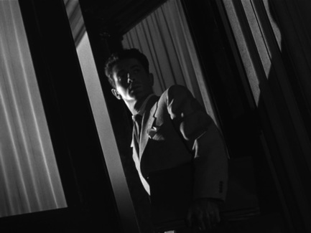
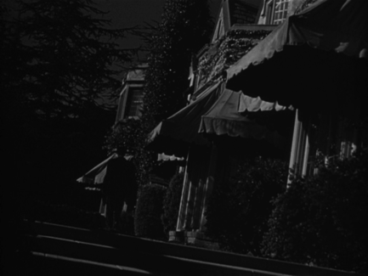
Strangers on a Train
Cinematography
Framing (“Dutch angles”)

Slide 66
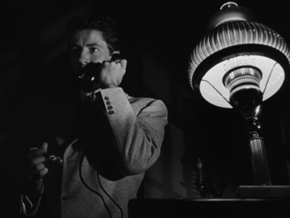
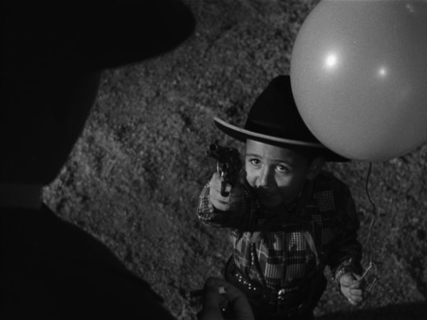
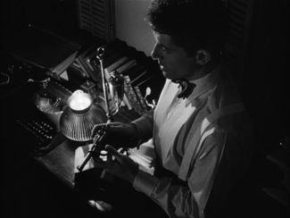
Strangers on a Train
Cinematography
Angles (high and low)

Slide 67
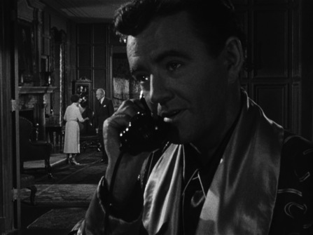
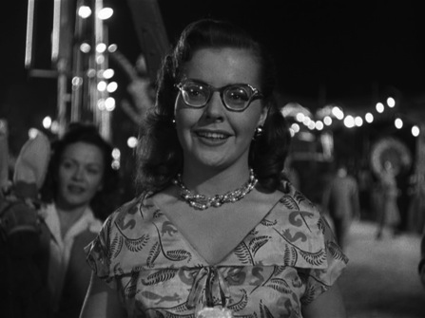
Strangers on a Train
Cinematography
Focus (deep and shallow)

Slide 68
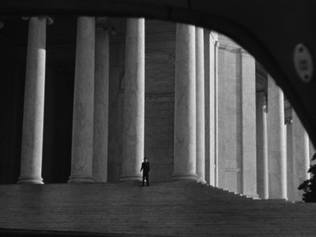
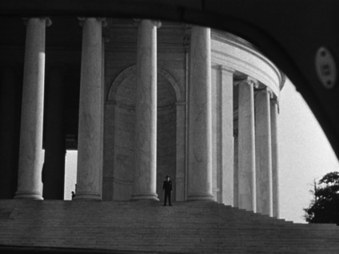
Strangers on a Train
Cinematography
Camera movement

Slide 69
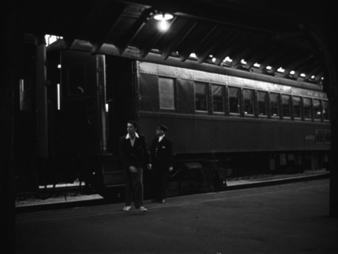
Strangers on a Train
Cinematography
Film stock (35mm black and white)

Slide 70
Strangers on a Train
Mise-en-scene
Production design
Set design
Set decoration
Props

Slide 71
Strangers on a Train

Slide 72
Strangers on a Train

Slide 73
Strangers on a Train

Slide 74
Strangers on a Train
Mise-en-scene
Costume design

Slide 75
Strangers on a Train
Mise-en-scene
Lighting

Slide 76
Strangers on a Train
Mise-en-scene
Figure expression and movement (acting)

Slide 77
Strangers on a Train
Mise-en-scene
Figure expression and movement (acting)

Slide 78
Strangers on a Train
Mise-en-scene
Figure expression and movement (acting)

Slide 79
Strangers on a Train
Mise-en-scene
Figure expression and movement (acting)

Slide 80
Strangers on a Train
Editing
Transitions (cross-dissolve or cross-fade)

Slide 81
Strangers on a Train
Editing
Transitions (cross-dissolve or cross-fade)

Slide 82
Strangers on a Train
Editing
Parallel editing

Slide 83
Strangers on a Train
Editing
Shot/reverse-shot

Slide 84
Strangers on a Train
Editing
Shot/reverse-shot

Slide 85
Strangers on a Train
Sound
Music

Slide 86
Strangers on a Train
Sound
Music

Slide 87
Strangers on a Train
Sound
Music

Slide 88
Strangers on a Train
Sound
Music and sound mix

Slide 89
Strangers on a Train
Sound
Off-screen sound

Slide 90
Strangers on a Train
Sound
Sound effects

